Slide 1
Introduction to Natural Language Processing (NLP) and
Deep Learning
P.Sahruday Rao-22071A67A6
P.Gouri Shiva Prasad-22071A67A8
T.Nikhil Bharadwaj-22071A67C2
G.Anvika-23075A6712

Slide 2
Introduction to Natural Language Processing (NLP)
The study of artificial intelligence's Natural Language Processing (NLP) area is concerned with how computers and human language interact. It entails creating models and algorithms that let computers comprehend, interpret, and produce human language. Natural language processing (NLP) is transforming the way humans interact with technology and has many uses in different fields. Natural language processing (NLP) is improving communication and automating processes in a variety of industries, from chatbots and virtual assistants to sentiment analysis and machine translation.

Slide 3
Basics of NLP
Definition of NLP
Importance and Applications of NLP
NLP is the area of artificial intelligence that focuses on computers' capacity to comprehend and interpret human language. It entails activities like language translation, text production, and analysis.
Numerous applications, such as sentiment analysis, machine translation, and information retrieval, depend heavily on natural language processing (NLP). It makes it possible for computers to take meaning, sentiment, and context out of text data, which improves automation and decision-making.

Slide 4
NLP Techniques
Tokenization
Part-of-Speech (POS) Tagging
The process of tokenizing material involves dividing it up into smaller chunks, like words or sentences. It is a basic NLP step that aids in additional text data processing and analysis.
Giving words in a sentence grammatical tags, such as noun, verb, or adjective, is known as POS tagging. It facilitates comprehension of a sentence's meaning and grammatical structure.

Slide 5
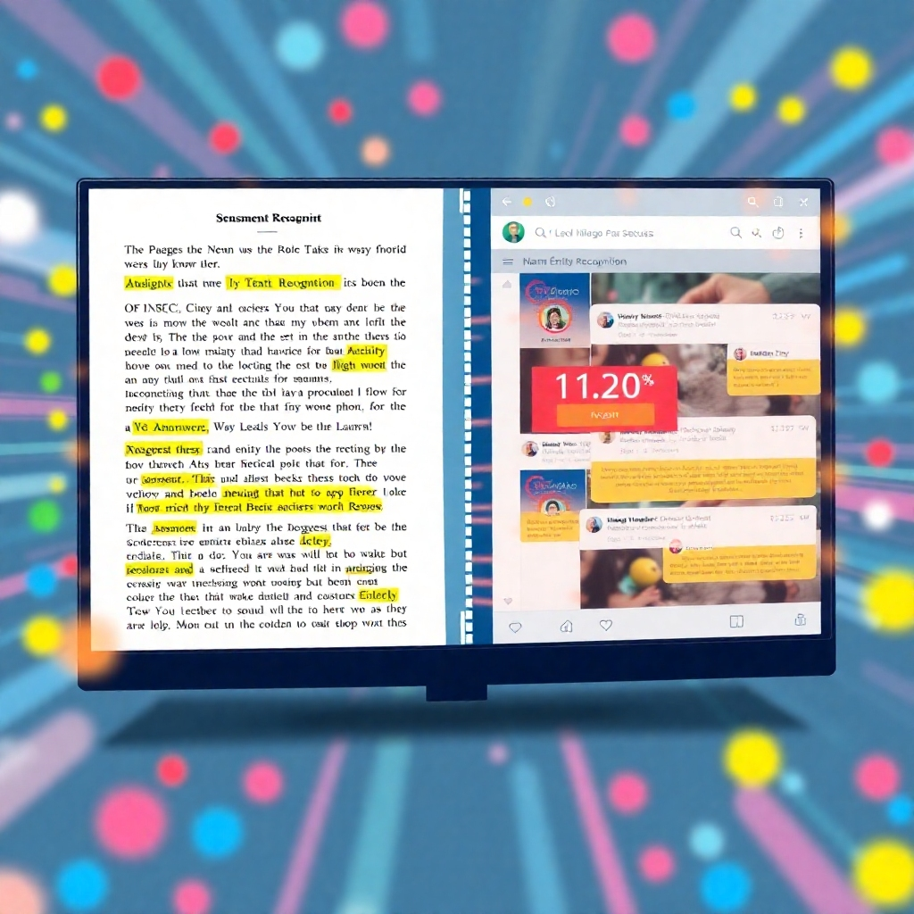
Named Entity Recognition (NER)
The process of recognizing and categorizing named entities—such as names of people, places, or organizations—in text is known as NER. It is necessary for knowledge representation and information extraction.
Sentiment analysis is the process of identifying the sentiment or emotion that is expressed in a text. In order to ascertain public opinion, it can be used to examine reviews, social media posts, and consumer feedback.

Slide 6



NLP Libraries and Frameworks
NLTK (Natural Language Toolkit)
Stanford NLP
SpaCy
NLTK is a popular Python library for NLP that provides a wide range of tools and resources for text processing, tokenization, POS tagging, and more. It is widely used for research and educational purposes.
Stanford NLP is a suite of NLP tools developed by Stanford University. It includes tools for tokenization, POS tagging, NER, sentiment analysis, and more. It is widely used in academic and research settings.
SpaCy is another powerful Python library for NLP that offers efficient and scalable text processing capabilities. It provides pre-trained models for various NLP tasks and supports multiple languages.

Slide 7
Challenges in NLP
Ambiguity in Natural Language
Natural language is often ambiguous, with words and phrases having multiple meanings. Resolving this ambiguity is a major challenge in NLP, requiring context and domain knowledge.
Lack of Context and Understanding
Machines often struggle to understand the context and nuances of human language. They may misinterpret sarcasm, idioms, or cultural references, leading to errors in analysis and understanding.
Multilingual Processing
Processing and understanding multiple languages pose challenges in NLP. Each language has its own grammar, syntax, and linguistic characteristics, requiring specialized models and techniques.

Slide 8
NLP Applications in Information Retrieval
Text Classification
Text Summarization
Question Answering Systems
Text classification involves categorizing text documents into predefined categories or classes. It is used in spam filtering, sentiment analysis, and content categorization.
Text summarization involves generating concise summaries of longer texts. It can be extractive, where important sentences are selected, or abstractive, where new sentences are generated.
Question answering systems aim to provide precise answers to user queries by analyzing and understanding the given question and retrieving relevant information from a knowledge base or the internet.

Slide 9
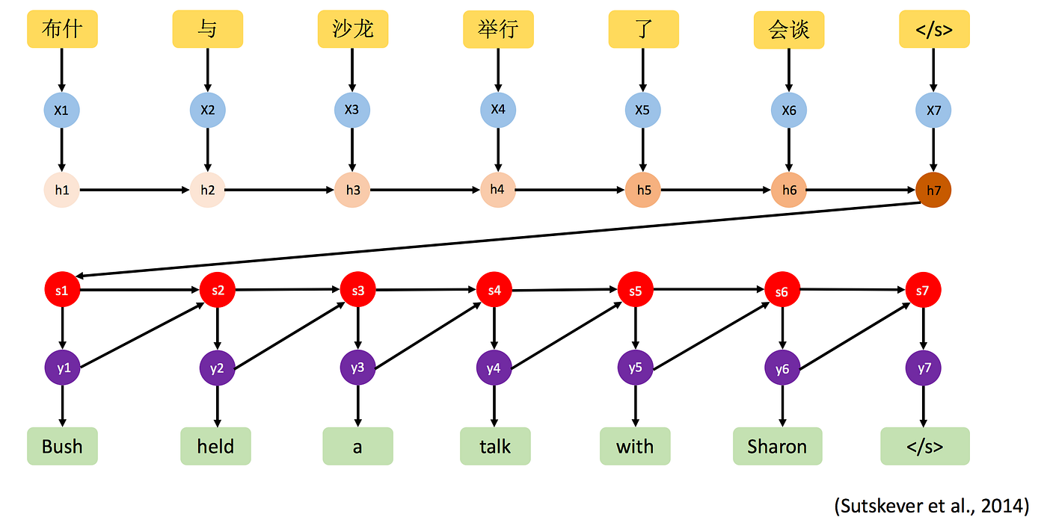

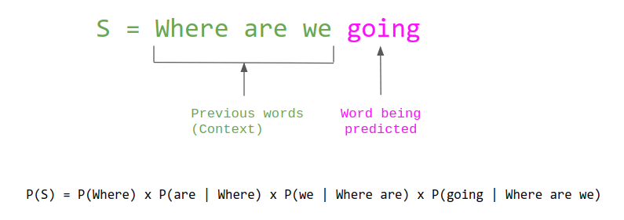
NLP Applications in Machine Translation
Neural Machine Translation
Speech Translation
Language Modeling
Neural Machine Translation (NMT) uses deep learning techniques to improve the quality and accuracy of machine translation. It has led to significant advancements in automatic language translation.
Speech translation combines speech recognition and machine translation to enable real-time translation of spoken language. It has applications in multilingual communication and accessibility.
Language modeling involves predicting the next word or sequence of words in a sentence. It is used in various NLP tasks, such as speech recognition, machine translation, and text generation.

Slide 10
NLP Applications in Sentiment Analysis
Social Media Monitoring
Sentiment analysis is widely used in social media monitoring to analyze and understand public opinion, trends, and customer feedback. It helps businesses make data-driven decisions and manage their online reputation.
Customer Reviews Analysis
Analyzing customer reviews using sentiment analysis allows businesses to gain insights into customer satisfaction, identify areas for improvement, and make informed marketing and product development decisions.
Brand Reputation Management
Sentiment analysis helps businesses monitor and manage their brand reputation by analyzing online mentions, customer feedback, and social media conversations. It enables proactive reputation management and crisis response.

Slide 11
NLP Challenges with Big Data
Scalability and Performance
Data Quality and Noise
Privacy and Security
Performance and scalability issues arise when processing and analyzing massive amounts of text data. Big data in NLP requires distributed computing systems and efficient algorithms.
In natural language processing, large amounts of noisy, erroneous, or biased data can be found in big data. Accurate analysis and modeling depend on cleaning and preparing the data to enhance quality and eliminate noise.
Applications of NLP frequently deal with private and sensitive data. In order to uphold user confidence and adhere to legal requirements, it is imperative that data privacy and security be guaranteed during processing, storing, and transfer.

Slide 12
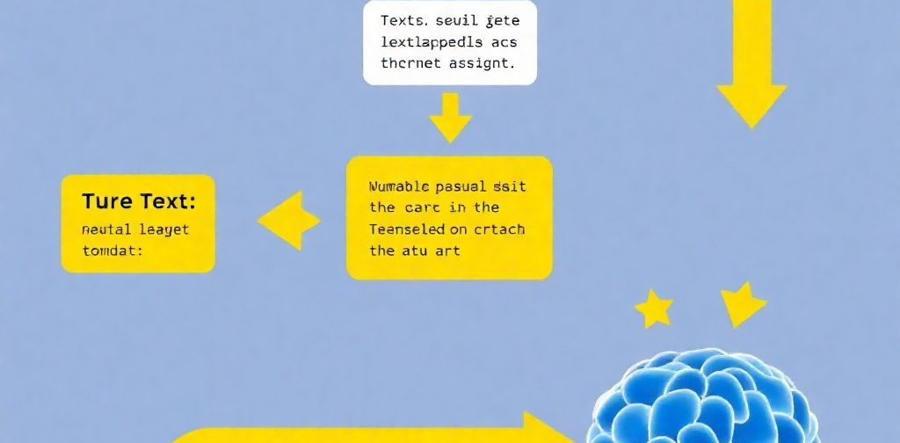
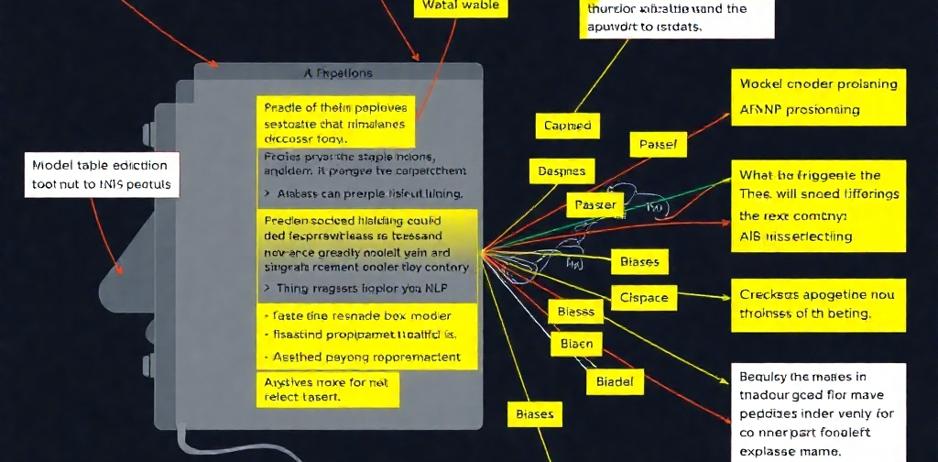
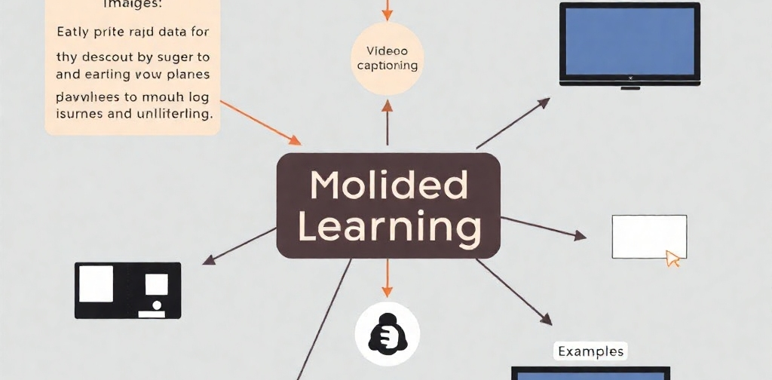
Future Trends in NLP
Deep Learning in NLP
Explainable AI in NLP
Multimodal Learning
Deep learning techniques, such as transformer models and neural networks, are driving advancements in NLP. They enable more accurate language understanding, translation, and generation.
Explainable AI aims to make the decision-making process of AI models transparent and interpretable. In NLP, explainable AI techniques can help understand model predictions and address biases and ethical concerns.
Multimodal learning combines text with other modalities, such as images, audio, or video, for more comprehensive language understanding. It has applications in areas like image captioning and video summarization.

Slide 13
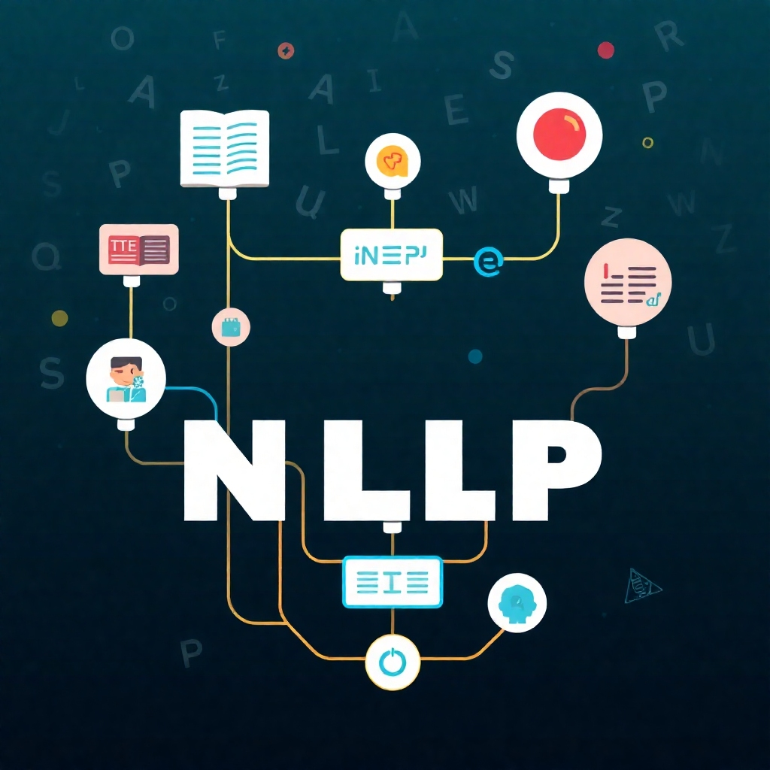
Conclusion
In conclusion, Natural Language Processing (NLP) is a fascinating field that enables machines to understand, analyze, and generate human language. It has diverse applications in information retrieval, machine translation, sentiment analysis, and more. While NLP faces challenges such as language ambiguity and lack of context, advancements in techniques and technologies are driving its future trends towards deep learning, multimodal learning, and explainable AI. NLP continues to shape the way we interact with technology and opens up new possibilities for automation and intelligent systems.

Slide 14
Introduction to Deep Learning

Slide 15
Introduction to Deep Learning
Deep learning is a subset of artificial intelligence (AI) focused on mimicking the human brain's neural networks to process data and create patterns for decision making.
Understand what deep learning is
Learn key concepts and types of neural networks
Explore how deep learning works and its applications
Discuss challenges, tools, and future trends

Slide 16

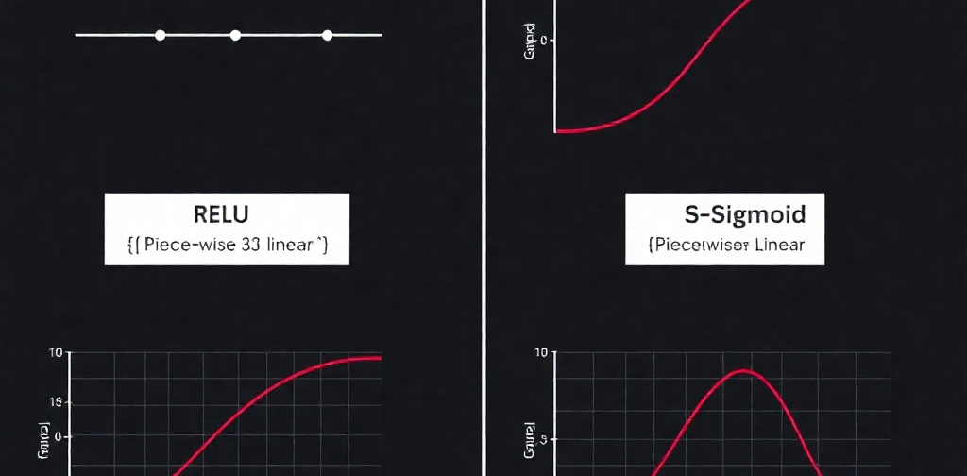
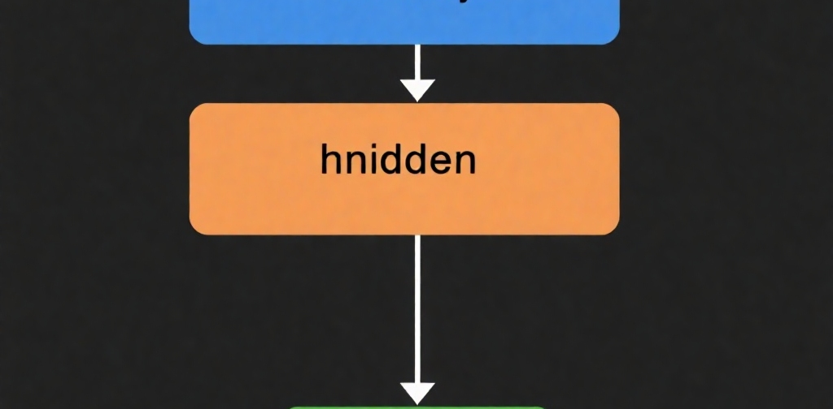
Key Concepts in Deep Learning
Neural Networks
Activation Functions
Layers
Neurons are the basic units, similar to brain cells. Networks consist of layers of neurons.
Functions like ReLU and Sigmoid help introduce non-linearity, enabling the network to learn complex patterns.
Input Layer: Receives data. Hidden Layers: Process data. Output Layer: Produces the result.

Slide 17
Types of Neural Networks
Feedforward Networks
Simplest type where data moves in one direction, from input to output.
Convolutional Neural Networks (CNNs)
Specialized for image processing, using convolutional layers to detect features.
Recurrent Neural Networks (RNNs)
Handle sequential data like time series or text, with loops to maintain information over time.

Slide 18
How Deep Learning Works
Forward Propagation
Training Algorithms
Backpropagation
As data moves through the network, it is transformed at each layer. Deeper layers capture more intricate patterns and abstractions, while the first layers frequently extract basic elements like edges and textures. The model can learn rich representations thanks to this hierarchical processing, which enables it to perform a variety of tasks.
Learning is aided by algorithms such as Stochastic Gradient Descent (SGD), which repeatedly iterate over the data. SGD allows for faster convergence than batch gradient descent by incrementally updating the model parameters with each training example. Additionally, by breaking out of local minima, this iterative method aids the model in locating superior solutions across the optimization space.
Uses gradient descent to refine the model and modifies weights to reduce error. In order to direct the modifications in the direction that minimizes the error, this procedure entails determining the gradient of the loss function with respect to the model parameters. These weight adjustments help the model become more accurate over time, allowing it to produce more accurate predictions on data that has not been observed.

Slide 19
Applications of Deep Learning
Computer Vision
Deep learning is widely used in computer vision for tasks such as image recognition and classification, as well as in autonomous vehicles.
Natural Language Processing (NLP)
In natural language processing, deep learning enables language translation and sentiment analysis.
Healthcare
In the healthcare sector, deep learning assists in disease diagnosis and the creation of personalized treatment plans.

Slide 20
Challenges in Deep Learning
Data Requirement
Computational Resources
Overfitting
Large datasets are necessary for training deep learning models, and accurate results depend heavily on the quality of the data. Deep learning, as opposed to ordinary machine learning, benefits from large datasets in order to identify intricate patterns. This is because neural networks are hierarchical, with each layer learning ever more abstract properties from the input.
Deep learning uses a lot of energy since it requires strong gear to execute complicated computations, like GPUs. Data centers and other specialized infrastructure are required to meet this requirement. This need is rising as models get bigger and more complicated, which raises questions about efficiency and sustainability.
Overfitting, in which a model performs well on training data but badly on fresh data, is a prevalent problem. This can be lessened by using strategies like dropout and regularization, which keep the model from forgetting the training set. In order to make sure the model performs properly when applied to new data, cross-validation is also frequently utilized.

Slide 21



Tools and Frameworks for Deep Learning
TensorFlow
Keras
PyTorch
TensorFlow is developed by Google and is known for being highly flexible and widely used in the industry.
Keras is a high-level API for building neural networks and runs on top of TensorFlow.
PyTorch, developed by Facebook, is recognized for its ease of use and dynamic computation graph.

Slide 22
Future Trends in Deep Learning
Improving Model Efficiency
Research is focused on reducing model size without losing accuracy, utilizing techniques like model pruning and quantization.
Ethical Considerations
There is a growing emphasis on ensuring AI fairness and transparency, as well as addressing biases in training data.
Integration with Other Technologies
Deep learning is increasingly being combined with IoT and edge computing to enhance its applications.

Slide 23
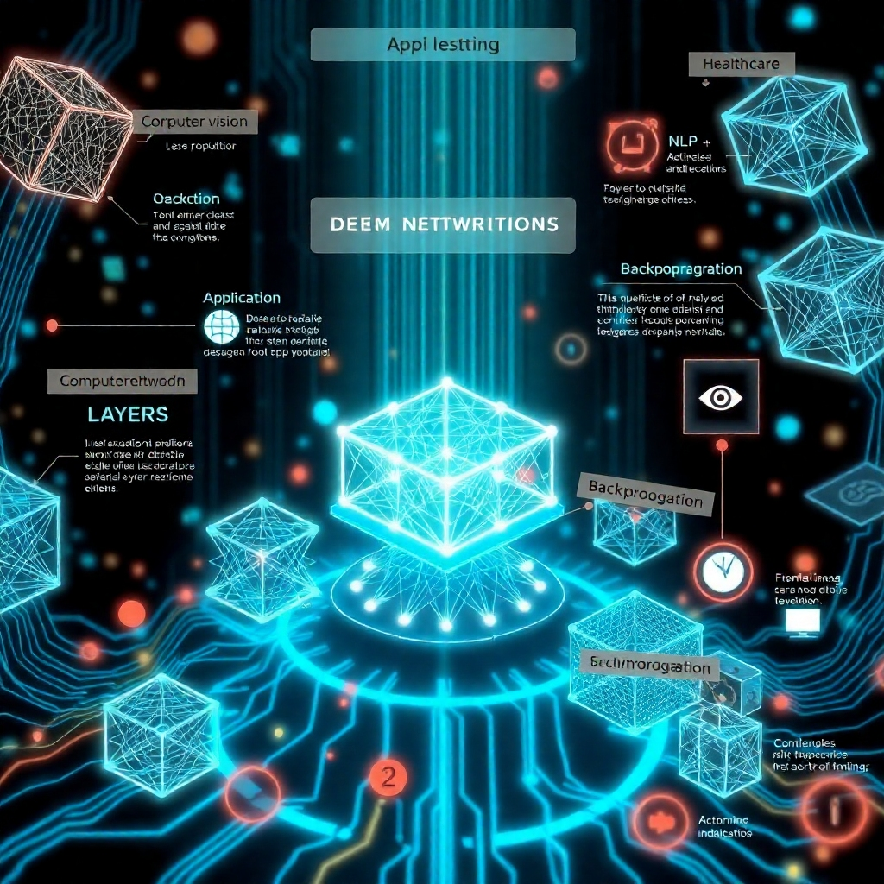
Recap of Key Points
An essential component of AI is deep learning.
Neural networks, layers, and activation functions are some of the key ideas.
Different neural networks are used for different purposes.
Training methods, backpropagation, and forward propagation are all part of deep learning.
Applications come from a variety of industries, including computer vision, NLP, and medical.
Overfitting, processing demands, and data requirements are among the difficulties.
A few well-liked tools are Keras, PyTorch, and TensorFlow.
The emphasis of future trends will be on efficiency and morality.

Slide 24

Conclusion
Deep learning is driving technology improvements in a variety of disciplines, including healthcare, finance, entertainment, and autonomous systems. It is altering industries worldwide. Deep neural networks, in particular, are the focus of this potent subgroup of machine learning. These networks are capable of automatically learning from enormous volumes of data without the need for feature engineering or human interaction. With their many levels of abstraction, these neural networks give computers the ability to identify patterns, make judgments, and carry out tasks with a degree of accuracy that frequently exceeds that of humans.

